Slide 1


Raeez Spence
Student Number: ST10085639
PROGRAMMING 2B PART 3
Programme Code:
BCAD2
Module Lecturer:
Courteney Young
Module Code:
PROG6212
Date of Submission:
21-11-2025

Slide 2
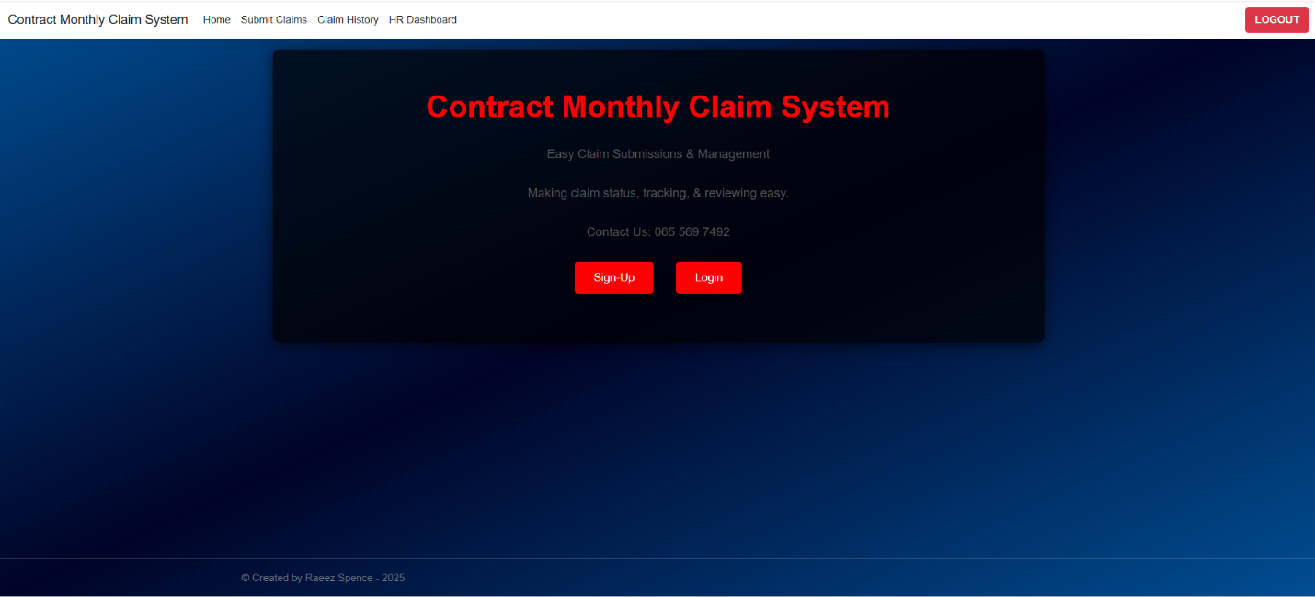
Home Page
Purpose: Serves as the landing page after login, welcoming users to the Claims Management and Control System (CMCS).
Functions:
Provides navigation to all major sections (Submit Claims, Claim History, Admin Dashboard, HR Dashboard).
Displays general announcements or system updates.
Sign-Up & Login buttons.

Slide 3
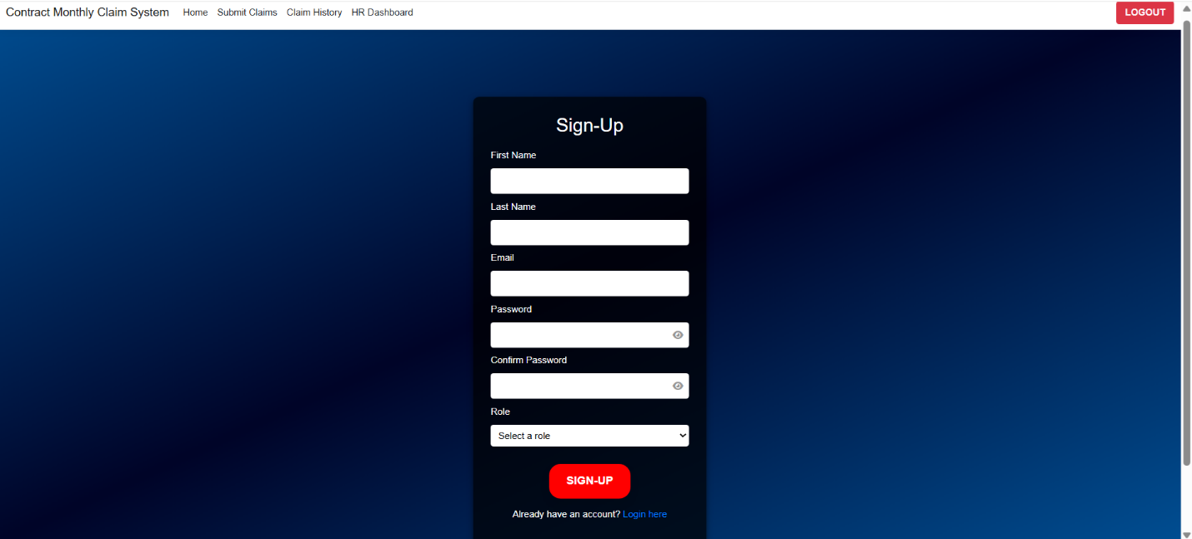
Sign-Up Page
Purpose: Enables new users to register for a CMCS account by submitting their details and selecting their role.
Functions:
Input Fields: Collects user information including first name, last name, email address, password, and confirmation password.
Role Selection: Allows users to choose their system role (e.g., Academic Manager, Program Coordinator, Lecturer, HR).
Sign-Up Button: Submits the registration form to create a new account in the system.
Login Redirect: Provides a link for users who already have an account.
Navigation Bar: Maintains a consistent design and allows smooth navigation across the CMCS platform.

Slide 4
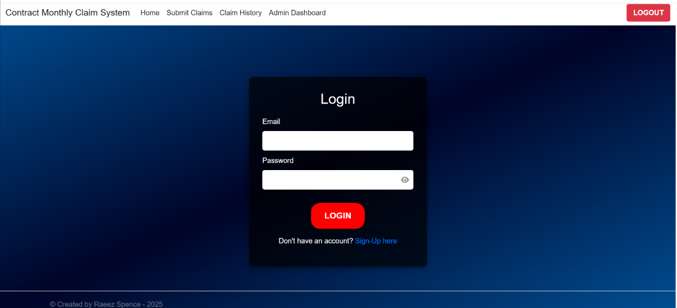
Login Page
Purpose: Allows registered users to securely access their CMCS account by verifying their credentials.
Functions:
Email & Password Fields: Users enter their registered credentials (passwords are masked for security).
Login Button: Authenticates credentials and redirects users to the appropriate dashboard or homepage.
Sign-Up Link: Directs new users to the registration page.
Navigation Bar: Provides quick access to other pages (Home, Submit Claims, Claim History, etc.) and shows a Logout button once logged in.

Slide 5
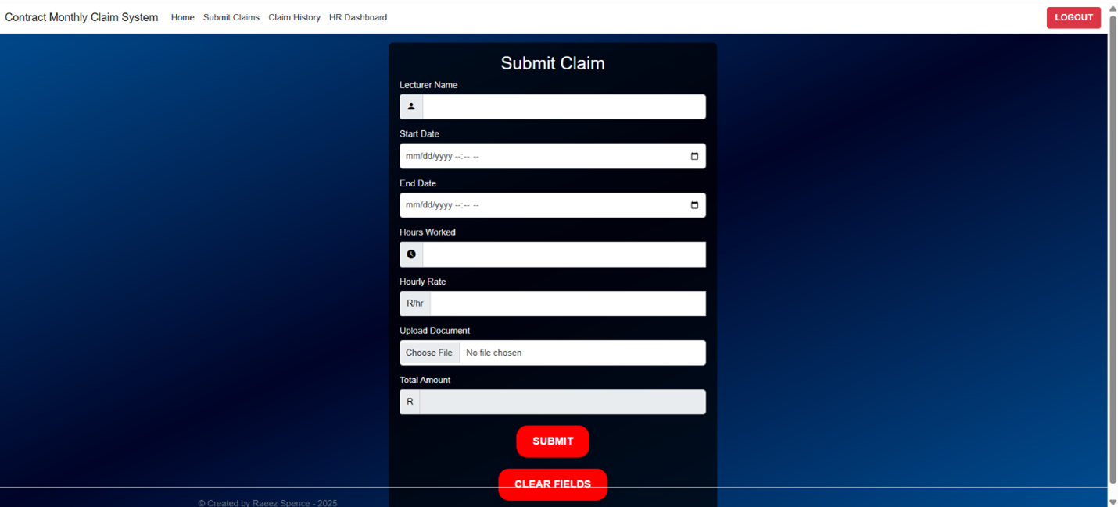
Submit Claims Page
Purpose: Allows users to submit new claim requests. Only Lecturers can access. (Lecturers get redirected here once logged in.)
Functions:
Users can enter claim details such as claim type, amount, and reason.
Upload supporting documents (PDF, jpg, jpeg or docx).
Submit button stores the claim in the system database for admin review. Redirects to Claim History Page.
Clear Fields button clears the form fields.

Slide 6
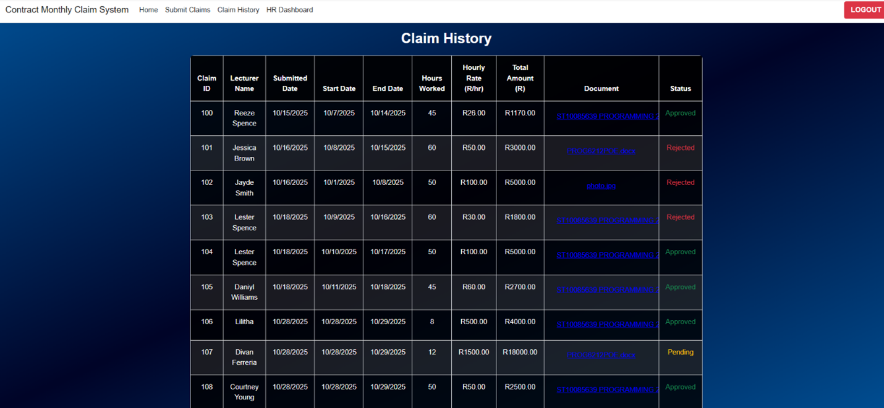
Claim History Page
Purpose: Displays a record of all submitted claims by the user. Only Lecturers can access. (Lecturers get redirected here once submitted claim.)
Functions:
Shows claim details such as claim ID, submission date, claim amount, and current status (Pending, Approved, or Rejected).
Helps users track the progress of each claim over time.

Slide 7
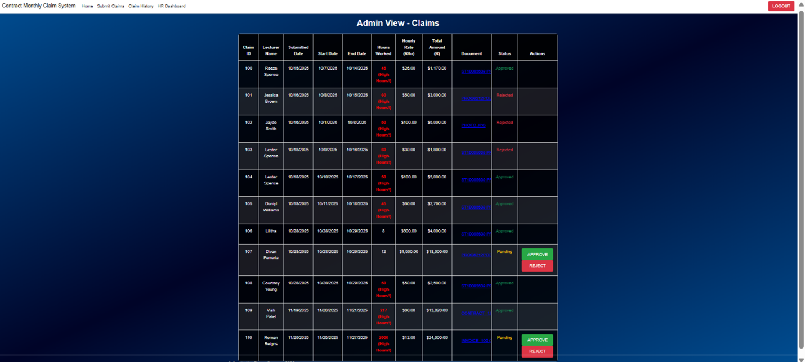
Admin Dashboard
Page
Purpose: Provides administrative tools for managing and reviewing claims. Only Admin can access. (Prog-Coordinator & Academic Manager get redirected here once logged in.)
Functions:
Displays all claims from users with their details.
Admins can update each claim’s status (Approved, Pending, Rejected).

Slide 8
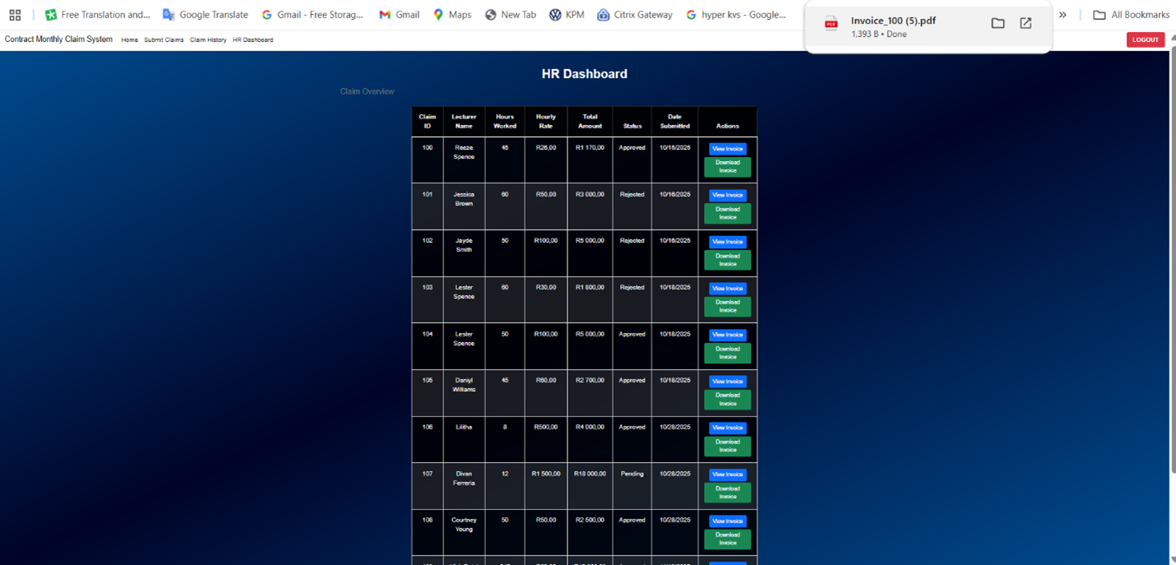
HR Dashboard
Page
Purpose: Provides HR tools for managing and reviewing claims, providing invoices. Only HR can access. (HR get redirected here once logged in.)
Functions:
Displays all claims from users with their details.
HR can view and download invoices.
Blue View Invoice button will direct to invoice page.
Green Download button will download invoice.

Slide 9
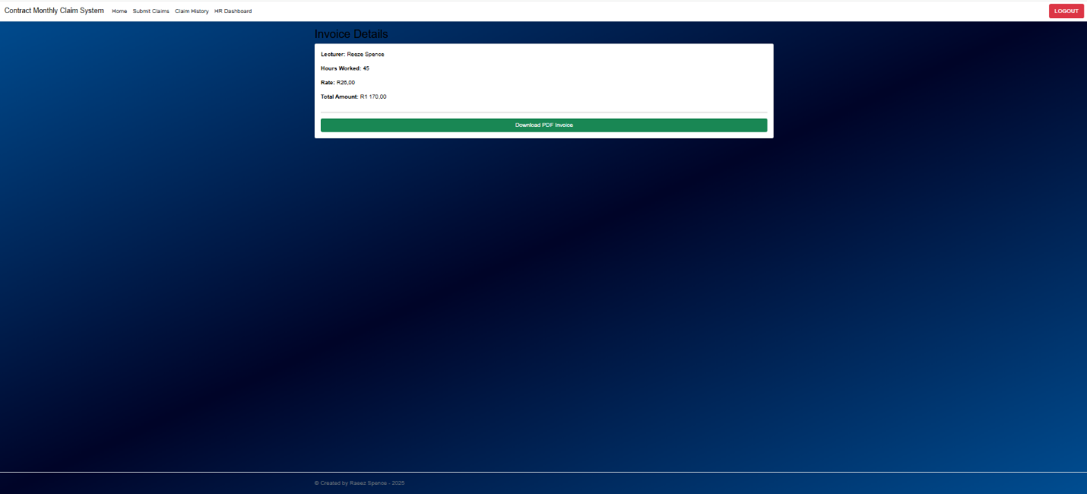
HR Invoice
Page
Purpose: Provides an invoice with claim details to review. Only HR can access. (HR get redirected here once clicking Blue Invoice button on previous page.)
Functions:
Displays claim from user with the details of that specific claim.
HR can download invoice.

Slide 10
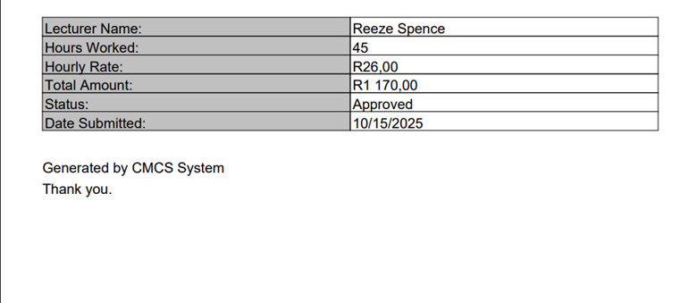
HR Invoice PDF
Purpose: Provides an invoice with claim details to review in PDF. Only HR can access. (HR gets downloaded once clicking Green Download button on previous page or HR Dashboard.)

Slide 11
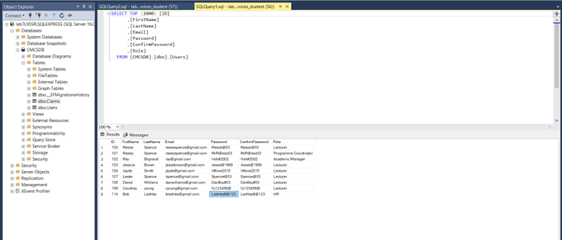
Users SQL Table
Stores credentials, roles, and user details.

Slide 12
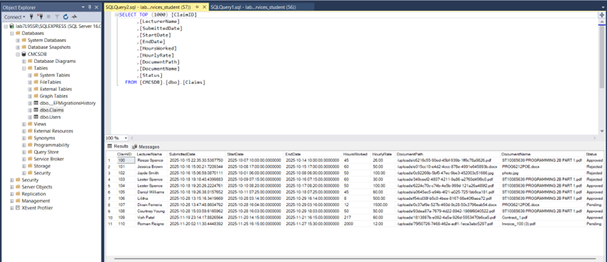
Claims SQL Table
Tracks claims with details such as submission date, hours worked, and approval status.

Slide 13
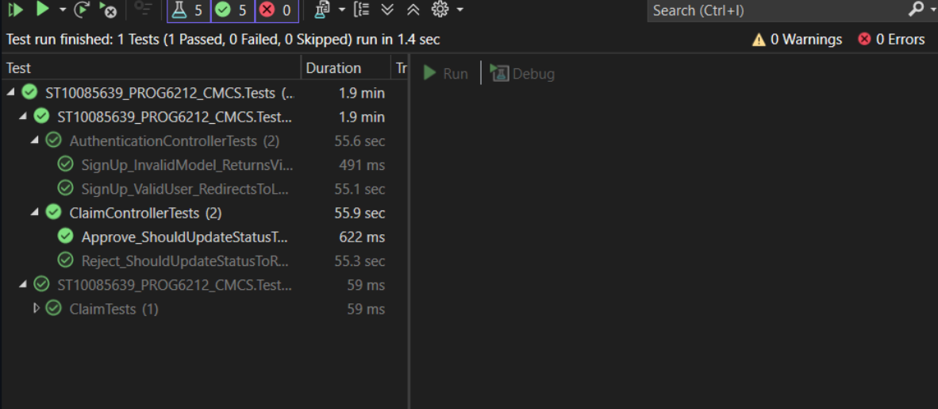
Unit Testing
The project includes a unit test project (ST10085639_PROG6212_CMCS.Tests).
To run the tests:
In Visual Studio, open the Test Explorer (View → Test Explorer).
Click Run All Tests to execute all available test cases.

Slide 14
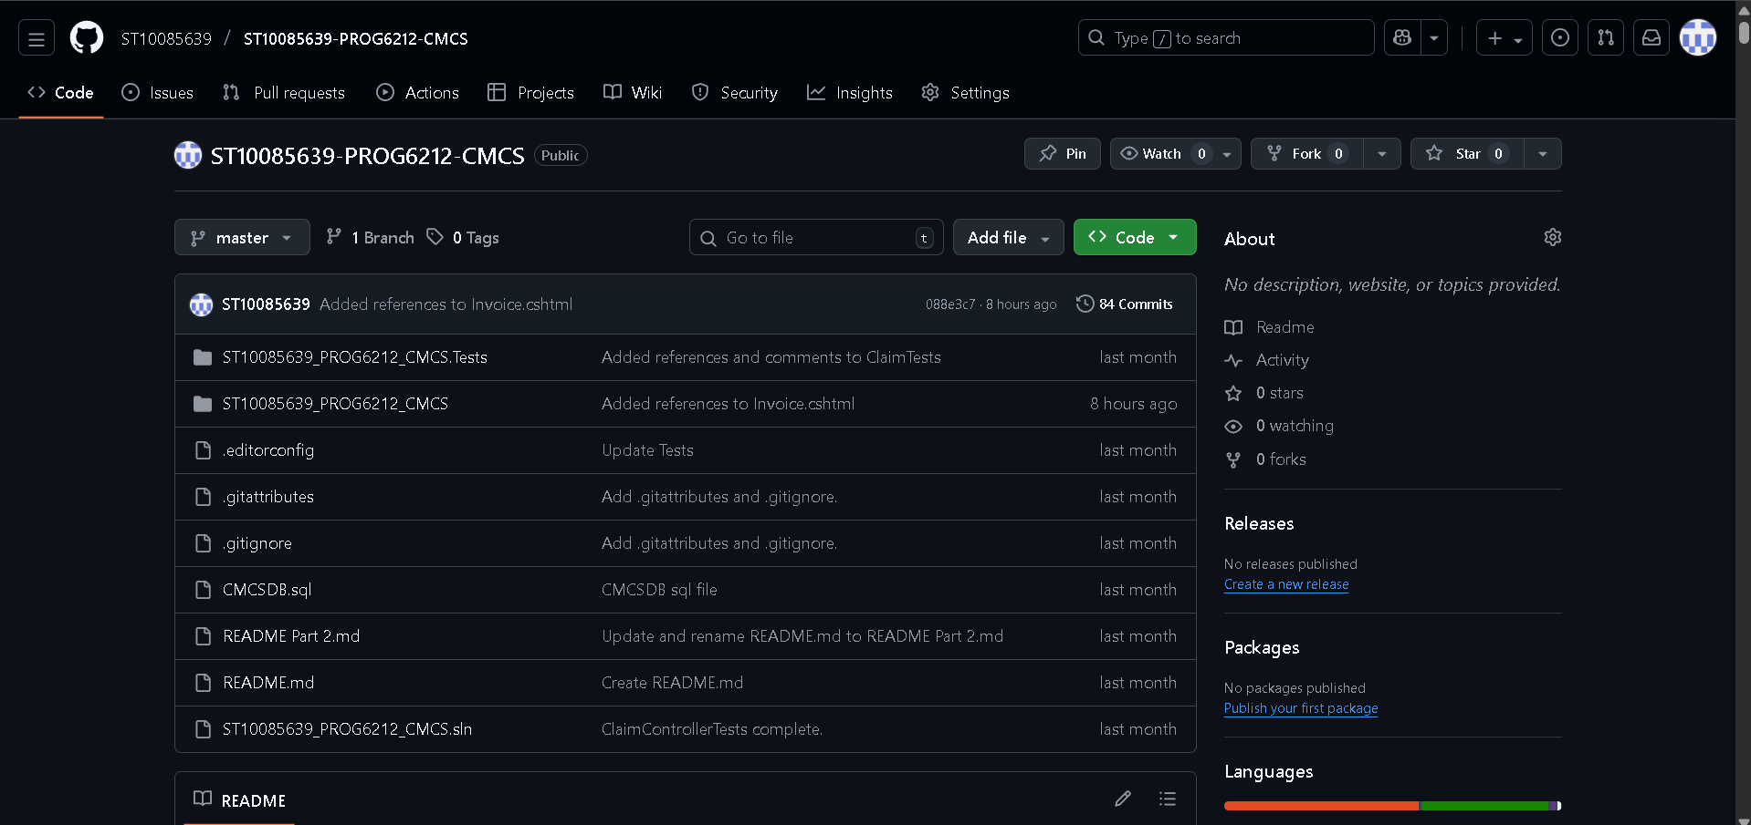
GitHub Repo
Link:
https://github.com/ST10085639/ST10085639-PROG6212-CMCS

Slide 15
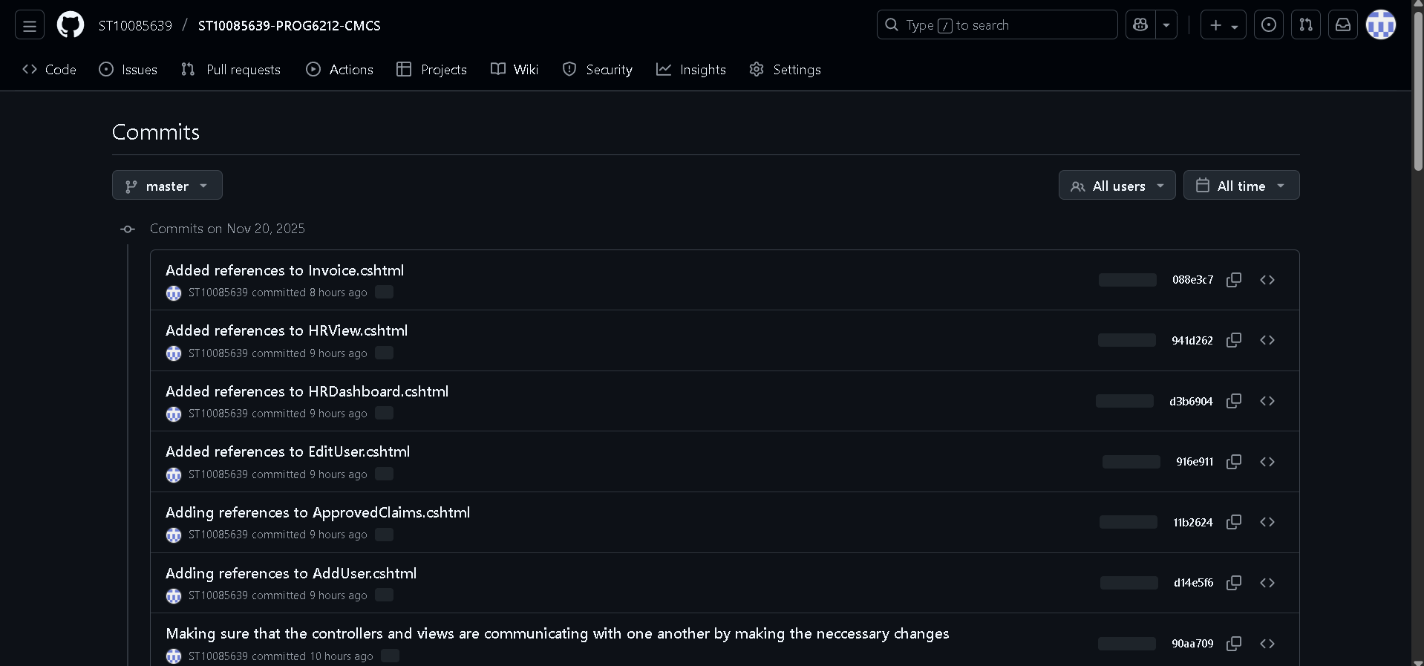
GitHub Commits
Link:
https://github.com/ST10085639/ST10085639-PROG6212-CMCS

Slide 16
References:
🏠 HomeController
Microsoft Learn. 2024. Handle requests with controllers in ASP.NET Core MVC, 17 June 2024. [Online].
Available at: https://learn.microsoft.com/en-us/aspnet/core/mvc/controllers/actions?view=aspnetcore-9.0
[Accessed 16 October 2025].
Microsoft Learn. 2024. Error handling in ASP.NET Core, 25 September 2025. [Online].
Available at: https://learn.microsoft.com/en-us/aspnet/core/fundamentals/error-handling?view=aspnetcore-9.0
[Accessed 16 October 2025].
Microsoft Learn. 2024. Dependency injection in ASP.NET Core, 18 September 2024. [Online].
Available at: https://learn.microsoft.com/en-us/aspnet/core/fundamentals/dependency-injection?view=aspnetcore-9.0
[Accessed 16 October 2025].
Microsoft Learn. 2024. Routing in ASP.NET Core, 18 September 2024. [Online].
Available at: https://learn.microsoft.com/en-us/aspnet/core/fundamentals/routing?view=aspnetcore-9.0
[Accessed 16 October 2025].
TutorialsTeacher. 2024. ASP.NET Core MVC Tutorial, 2024. [Online].
Available at: https://www.tutorialsteacher.com/core/aspnet-core-mvc
[Accessed 16 October 2025].

Slide 17
References:
🧾 ClaimController
Microsoft Learn. 2024. Model binding in ASP.NET Core MVC, 19 July 2025. [Online].
Available at: https://learn.microsoft.com/en-us/aspnet/core/mvc/models/model-binding
[Accessed 16 October 2025].
Microsoft Learn. 2024. File uploads in ASP.NET Core, 27 September 2024. [Online].
Available at: https://learn.microsoft.com/en-us/aspnet/core/mvc/models/file-uploads
[Accessed 16 October 2025].
Microsoft Learn. 2024. Entity Framework Core basics, 12 November 2024. [Online].
Available at: https://learn.microsoft.com/en-us/ef/core/
[Accessed 16 October 2025].
Microsoft Learn. 2024. Authorization and role management in ASP.NET Core, 14 October 2024. [Online].
Available at: https://learn.microsoft.com/en-us/aspnet/core/security/authorization/roles
[Accessed 16 October 2025].
TutorialsTeacher. 2024. ASP.NET Core MVC CRUD Operations, 2024. [Online].
Available at: https://www.tutorialsteacher.com/core/aspnet-core-crud
[Accessed 16 October 2025].

Slide 18
References:
🔐 AuthenticationController
Microsoft Learn. 2024. Authentication and authorization in ASP.NET Core, 14 February 2024. [Online].
Available at: https://learn.microsoft.com/en-us/aspnet/core/security/authentication/
[Accessed 16 October 2025].
Microsoft Learn. 2024. Session and state management in ASP.NET Core, 24 April 2024. [Online].
Available at: https://learn.microsoft.com/en-us/aspnet/core/fundamentals/app-state
[Accessed 16 October 2025].
Microsoft Learn. 2024. Model validation in ASP.NET Core MVC, 28 August 2024. [Online].
Available at: https://learn.microsoft.com/en-us/aspnet/core/mvc/models/validation
[Accessed 16 October 2025].
Microsoft Learn. 2024. Razor Pages and MVC views in ASP.NET Core, 17 July 2024. [Online].
Available at: https://learn.microsoft.com/en-us/aspnet/core/mvc/views/overview
[Accessed 16 October 2025].
TutorialsTeacher. 2024. ASP.NET Core Authentication Tutorial, 2024. [Online].
Available at: https://www.tutorialsteacher.com/core/aspnet-core-authentication
[Accessed 16 October 2025].

Slide 19
References:
🧾 HRController
Microsoft. 2022. ASP.NET MVC Controller Overview (C#), 11 July 2022. [Online].
Available at: https://learn.microsoft.com/en-us/aspnet/mvc/overview/older-versions-1/controllers-and-routing/aspnet-mvc-controllers-overview-cs
[Accessed 20 November 2025].
Microsoft. 2022. Understanding Models, Views, and Controllers (C#), 11 July 2022. [Online].
Available at: https://learn.microsoft.com/en-us/aspnet/mvc/overview/older-versions-1/overview/understanding-models-views-and-controllers-cs
[Accessed 20 November 2025].
Microsoft. 2025. Part 6, controller methods and views in ASP.NET Core, 2 March 2025. [Online].
Available at: https://learn.microsoft.com/en-us/aspnet/core/tutorials/first-mvc-app/controller-methods-views?view=aspnetcore-9.0
[Accessed 20 November 2025].

Slide 20
References:
🗃 ApplicationDbContext in Data
Microsoft Learn. 2024. DbContext in Entity Framework Core, 12 November 2024. [Online].
Available at: https://learn.microsoft.com/en-us/ef/core/dbcontext-configuration/
[Accessed 16 October 2025].
Microsoft Learn. 2024. Configuring entity properties with the Fluent API in EF Core, 28 March 2024. [Online].
Available at: https://learn.microsoft.com/en-us/ef/core/modeling/
[Accessed 16 October 2025].
TutorialsTeacher. 2024. ASP.NET Core EF Core Tutorial, 2024. [Online].
Available at: https://www.tutorialsteacher.com/core/aspnet-core-ef-core
[Accessed 16 October 2025].

Slide 21
References:
⚙️ Program Class
Microsoft Learn. 2024. ASP.NET Core application startup, 12 December 2024. [Online].
Available at: https://learn.microsoft.com/en-us/aspnet/core/fundamentals/startup
[Accessed 16 October 2025].
Microsoft Learn. 2024. Routing in ASP.NET Core, 18 September 2024. [Online].
Available at: https://learn.microsoft.com/en-us/aspnet/core/fundamentals/routing
[Accessed 16 October 2025].
Microsoft Learn. 2024. Session state in ASP.NET Core, 24 April 2024. [Online].
Available at: https://learn.microsoft.com/en-us/aspnet/core/fundamentals/app-state
[Accessed 16 October 2025].

Slide 22
References:
📑 Claims Class in Models
Microsoft Learn. 2024. Data annotations in ASP.NET Core MVC, 28 August 2025. [Online].
Available at: https://learn.microsoft.com/en-us/aspnet/core/mvc/models/validation
[Accessed 16 October 2025].
Microsoft Learn. 2024. Working with DateTime in C#, 2024. [Online].
Available at: https://learn.microsoft.com/en-us/dotnet/api/system.datetime
[Accessed 16 October 2025].
Microsoft Learn. 2024. C# properties and methods, 14 November 2024. [Online].
Available at: https://learn.microsoft.com/en-us/dotnet/csharp/programming-guide/classes-and-structs/properties
[Accessed 16 October 2025].

Slide 23
References:
👤 Users Class in Models
Microsoft. 2024. Data annotations in ASP.NET Core MVC, 28 August 2024. [Online].
Available at: https://learn.microsoft.com/en-us/aspnet/core/mvc/models/validation?view=aspnetcore-9.0
[Accessed 16 October 2025].
Microsoft. 2024. Regular expressions in .NET, 18 July 2024. [Online].
Available at: https://learn.microsoft.com/en-us/dotnet/standard/base-types/regular-expression-language-quick-reference
[Accessed 16 October 2025].
TutorialsTeacher. 2024. ASP.NET Core MVC Model Validation, 2024. [Online].
Available at: https://www.tutorialsteacher.com/core/aspnet-core-model-validation
[Accessed 16 October 2025].
Microsoft. 2024. Identity and security in ASP.NET Core, 13 July 2024. [Online].
Available at: https://learn.microsoft.com/en-us/aspnet/core/security/authentication/identity
[Accessed 16 October 2025].

Slide 24
References:
💻 Views
Microsoft Learn. 2025. Razor syntax reference for ASP.NET Core, 27 August 2025. [Online].
Available at: https://learn.microsoft.com/en-us/aspnet/core/razor-pages
[Accessed 17 October 2025].
W3Schools. 2024. CSS Styling, 2024. [Online].
Available at: https://www.w3schools.com/css/
[Accessed 17 October 2025].
MDN Web Docs. 2025. HTML input element, 16 September 2025. [Online].
Available at: https://developer.mozilla.org/en-US/docs/Web/HTML/Element/input
[Accessed 17 October 2025].
MDN Web Docs. 2025. HTML DOM element type property, 10 April 2025. [Online].
Available at: https://developer.mozilla.org/en-US/docs/Web/API/HTMLInputElement/type
[Accessed 17 October 2025].
Font Awesome. 2024. Font Awesome 6, 2024. [Online].
Available at: https://fontawesome.com/
[Accessed 17 October 2025].
Microsoft Learn. 2025. Handling errors in ASP.NET Core, 25 September 2025. [Online].
Available at: https://learn.microsoft.com/en-us/aspnet/core/fundamentals/error-handling?view=aspnetcore-9.0
[Accessed 17 October 2025].
W3Schools. 2024. CSS Buttons, 2024. [Online].
Available at: https://www.w3schools.com/css/css3_buttons.asp
[Accessed 17 October 2025].
W3Schools. 2024. CSS Card Layout, 2024. [Online].
Available at: https://www.w3schools.com/howto/howto_css_cards.asp
[Accessed 17 October 2025].
Microsoft. 2024. Standard numeric and currency formatting, 22 October 2024. [Online]. Available at: https://learn.microsoft.com/dotnet/standard/base-types/standard-numeric-format-strings
[Accessed 20 November 2025].
Microsoft. 2024. Routing in ASP.NET Core MVC, 17 July 2024. [Online].
Available at: https://learn.microsoft.com/aspnet/core/mvc/controllers/routing
[Accessed 20 November 2025].
Microsoft. 2024. Globalization and localization, 2024. [Online].
Available at: https://learn.microsoft.com/dotnet/api/system.globalization.cultureinfo
[Accessed 20 September 2025].
Microsoft. 2024. Razor Pages and MVC views, 17 June 2024. [Online].
Available at: https://learn.microsoft.com/aspnet/core/mvc/views
[Accessed 20 September 2025].

Slide 25
References:
📑 Unit Testing
Microsoft Learn. 2024. Unit testing controller logic in ASP.NET Core, 17 July 2024. [Online]. Available at: https://learn.microsoft.com/en-us/aspnet/core/mvc/controllers/testing [Accessed 18 October 2025].
Microsoft Learn. 2022. In-memory database provider - EF Core, 23 November 2022. [Online]. Available at:https://learn.microsoft.com/en-us/ef/core/testing/in-memory [Accessed 18 October 2025].
Sharma, M. 2023. Mastering Unit Testing in .NET 6: Build Reliable and Maintainable Applications with xUnit and MSTest. Packt Publishing, 2023. [Online]. Available at: https://www.packtpub.com/en-us/product/mastering-unit-testing-in-net-6-9781803241766 [Accessed 18 October 2025].
Microsoft Learn. 2022. In-memory database provider - EF Core, 23 November 2022. [Online]. Available at: https://learn.microsoft.com/en-us/ef/core/testing/in-memory [Accessed 18 October 2025].
Microsoft Learn. 2024. Unit testing controller logic in ASP.NET Core, 17 July 2024. [Online]. Available at: https://learn.microsoft.com/en-us/aspnet/core/mvc/controllers/testing [Accessed 18 October 2025].
MSDN. 2025. Unit testing in .NET with MSTest, 27 March 2025. [Online]. Available at: https://learn.microsoft.com/en-us/dotnet/core/testing/unit-testing-with-mstest [Accessed 18 October 2025].

